Slide 1

MATHEMATICS
CLASS 1
LESSON # 27
Saturday, 08 May 2021
Lesson Code 1M27

Slide 2
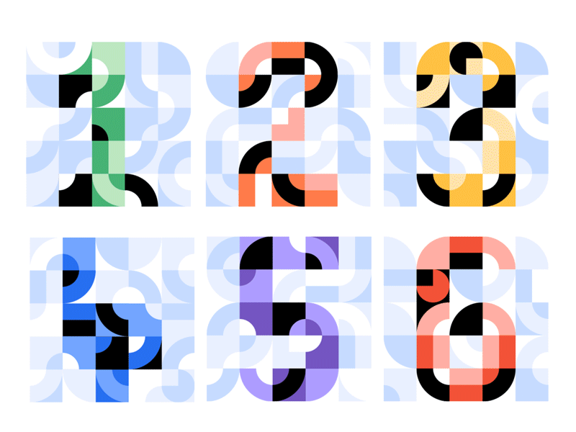
TOPIC: REINFORCEMENT
Forward counting and Number Name
One hundred and one (101)
to
Two hundred and fifty (250)

Slide 3
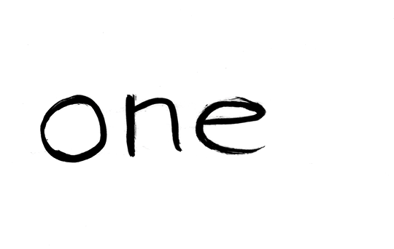
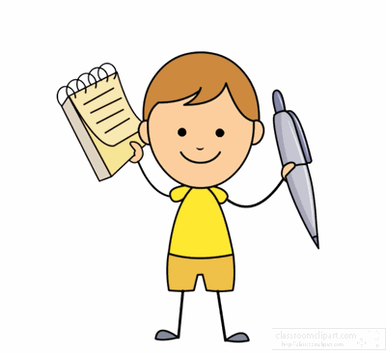
What is Number name?
Just like everything in the world, numbers too have a name.
In mathematics, Numbers have names in words(in spellings).

Slide 4
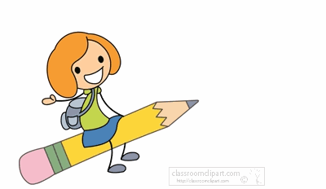
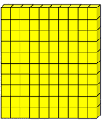



I’m number 101
I’m 3-digit number &
I have
1 hundred,
0 tens and
1 one.
Hundreds
Tens
Ones
100+0+1=101
Number name (In words )
One hundred and one

Slide 5
I’m number 108
I’m 3-digit number &
I have
1 hundred,
0 tens and
8 ones.
Hundreds
Tens
Ones
100+0+8=108
Number name (In words )
One hundred and eight

Slide 6
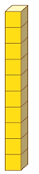
I’m number 110
I’m 3-digit number &
I have
1 hundred,
1 ten and
0 ones.
Hundreds
Tens
Ones
100+10+0=110
Number name (In words )
One hundred and ten

Slide 7
I’m number 119
I’m 3-digit number &
I have
1 hundred,
1 ten and
9 ones.
Hundreds
Tens
Ones
100+10+9=119
Number name (In words )
One hundred and nineteen

Slide 8
I’m number 120
I’m 3-digit number &
I have
1 hundred,
2 tens and
0 ones.
Hundreds
Tens
Ones
100+20+0=120
1 ten = 10
2 tens = 20
Number name (In words )
One hundred and twenty

Slide 9
I’m number 123
I’m 3-digit number &
I have
1 hundred,
2 tens and
3 ones.
Hundreds
Tens
Ones
100+20+3=123
Number name (In words )
One hundred and twenty three

Slide 10
I’m number 130
I’m 3-digit number &
I have
1 hundred,
3 tens and
0 ones.
Hundreds
Tens
Ones
100+30+0=130
1 ten = 10
2 tens = 20
3 tens = 30
Number name (In words )
One hundred and thirty

Slide 11
I’m number 134
I’m 3-digit number &
I have
1 hundred,
3 tens and
4 ones.
Hundreds
Tens
Ones
100+30+4=134
Number name (In words )
One hundred and thirty four

Slide 12
I’m number 140
I’m 3-digit number &
I have
1 hundred,
4 tens and
0 ones.
Hundreds
Tens
Ones
100+40+0=140
1 ten = 10
2 tens = 20
3 tens = 30
4 tens = 40
Number name (In words )
One hundred and forty

Slide 13
I’m number 150
I’m 3-digit number &
I have
1 hundred,
5 tens and
0 ones.
Hundreds
Tens
Ones
100+50+0=150
1 ten = 10
2 tens = 20
3 tens = 30
4 tens = 40
5 tens = 50
Number name (In words )
One hundred and fifty

Slide 14
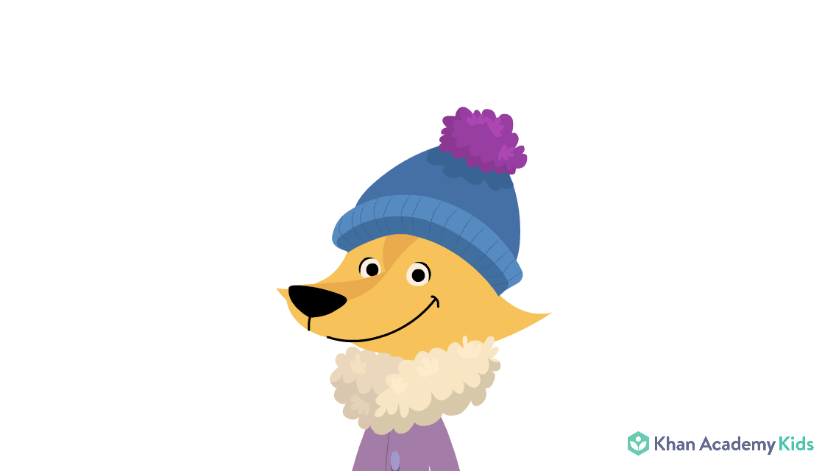

I’m number 160
I’m 3-digit number &
I have
1 hundred,
6 tens and
0 ones.
Hundreds
Tens
Ones
100+60+0=160
1 ten = 10
2 tens = 20
3 tens = 30
4 tens = 40
5 tens = 50
6 tens = 60
Number name (In words )
One hundred and sixty

Slide 15
I’m number 166
I’m 3-digit number &
I have
1 hundred,
6 tens and
6 ones.
Hundreds
Tens
Ones
100+60+6=166
Number name (In words )
One hundred and sixty six

Slide 16
I’m number 170
I’m 3-digit number &
I have
1 hundred,
7 tens and
0 ones.
Hundreds
Tens
Ones
100+70+0=170
1 ten = 10
2 tens = 20
3 tens = 30
4 tens = 40
5 tens = 50
6 tens = 60
7 tens = 70
Number name (In words )
One hundred and seventy

Slide 17
I’m number 180
I’m 3-digit number &
I have
1 hundred,
8 tens and
0 ones.
Hundreds
Tens
Ones
100+80+0=180
1 ten = 10
2 tens = 20
3 tens = 30
4 tens = 40
5 tens = 50
6 tens = 60
7 tens = 70
8 tens = 80
Number name (In words )
One hundred and eighty

Slide 18
I’m number 190
I’m 3-digit number &
I have
1 hundred,
9 tens and
0 ones.
Hundreds
Tens
Ones
1 ten = 10
2 tens = 20
3 tens = 30
4 tens = 40
5 tens = 50
6 tens = 60
7 tens = 70
8 tens = 80
9 tens = 90
100+90+0=190
Number name (In words )
One hundred and ninety

Slide 19
I’m number 199
I’m 3-digit number &
I have
1 hundred,
9 tens and
9 ones.
Hundreds
Tens
Ones
100+90+9=199
Number name (In words )
One hundred and ninety nine

Slide 20
I’m number 200
I’m 3-digit number &
I have
2 hundreds,
0 tens and
0 ones.
Hundreds
Tens
Ones
1 hundred = 100
2 hundreds = 200
200+00+0=200
1 ten = 10
2 tens = 20
3 tens = 30
4 tens = 40
5 tens = 50
6 tens = 60
7 tens = 70
8 tens = 80
9 tens = 90
10 tens = 100
Number name (In words )
Two hundred

Slide 21
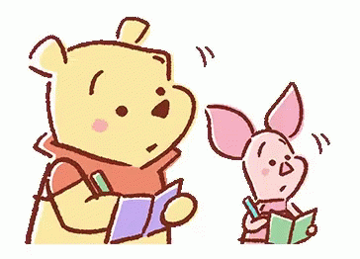
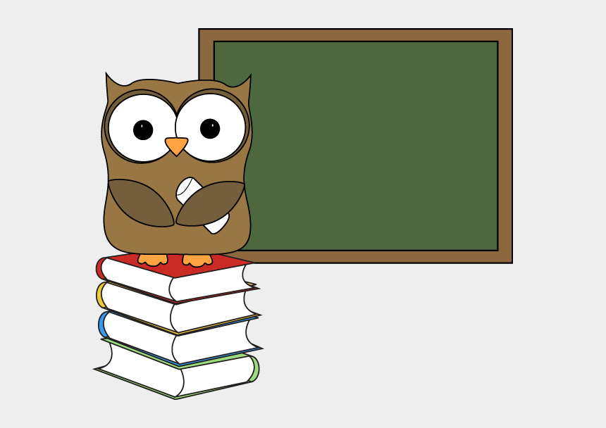
I’m number 201
I’m 3-digit number &
I have
2 hundreds,
0 tens and
1 one.
Hundreds
Tens
Ones
200+0+1=201
Number name (In words )
Two hundred and one

Slide 22
I’m number 210
I’m 3-digit number &
I have
2 hundreds,
1 ten and
0 ones.
Hundreds
Tens
Ones
200+10+0=210
1 ten = 10
Number name (In words )
Two hundred and ten

Slide 23
I’m number 220
I’m 3-digit number &
I have
2 hundreds,
2 tens and
0 ones.
Hundreds
Tens
Ones
200+20+0=220
Number name (In words )
1 ten = 10
2 tens = 20
Two hundred and twenty

Slide 24
I’m number 230
I’m 3-digit number &
I have
2 hundreds,
3 tens and
0 ones.
Hundreds
Tens
Ones
200+30+0=230
1 ten = 10
2 tens = 20
3 tens = 30
1 hundred = 100
2 hundreds = 200
Number name (In words )
Two hundred and thirty

Slide 25
I’m number 240
I’m 3-digit number &
I have
2 hundreds,
4 tens and
0 ones.
Hundreds
Tens
Ones
200+40+0=240
1 ten = 10
2 tens = 20
3 tens = 30
4 tens = 40
1 hundred = 100
2 hundreds = 200
Number name (In words )
Two hundred and forty

Slide 26
I’m number 250
I’m 3-digit number &
I have
2 hundreds,
5 tens and
0 ones.
Hundreds
Tens
Ones
200+50+0=250
1 ten = 10
2 tens = 20
3 tens = 30
4 tens = 40
5 tens = 50
1 hundred = 100
2 hundreds = 200
Number name (In words )
Two hundred and fifty

Slide 27
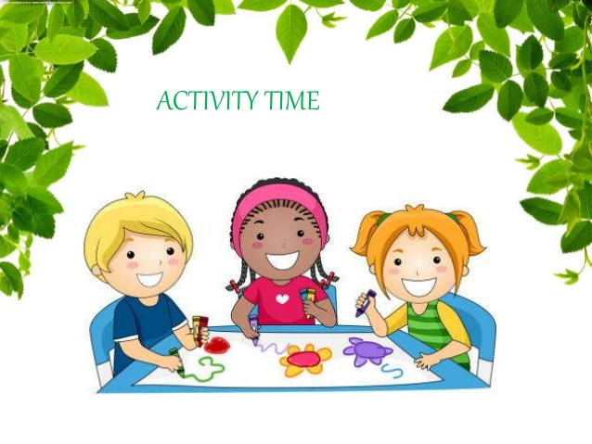

Slide 28
Activity
What comes after:
153
152 ______
200
199 ______
250
249 ______

Slide 29
Activity
Complete the given counting series.
93
120
121
119
92
91
123
117,118,_____ ,_____ , _____, 122, _____

Slide 30

Activity
Look at the given number and fill in the blanks. Also write the number name.
_______ Hundreds, _______tens and ________ ones
1
Number name
1
One hundred and ten
0

Slide 31
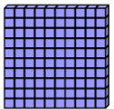
Activity
Look at the given blocks and form the number also write number name.
Number name
Number
154
One hundred and fifty four

Slide 32


Slide 33

Complete the given number table.
Number | Number name(In words)
1 3 9
1 4 8
 | Two hundred and two
1 5 7
 | Two hundred and twenty
1 6 6
2 0 0
One hundred and thirty nine
One hundred and forty eight
2 0 2
One hundred and fifty seven
2 2 0
One hundred and sixty six
Two hundred

Slide 34


Question # 1
I’m number 242
What’s my number name?
Number name ( In words)
Two hundred and forty two

Slide 35
Question # 2
I’m number 109
What’s my number name?
Number name ( In words)
One hundred and nine

Slide 36



Question # 3
I have 1 hundred 5 tens and 0 ones .
Which number am I ?
Number
150

Slide 37
Question # 4
I have 2 hundreds 1 ten and 7 ones .
What’s my number name?
Number name ( In words)
Two hundred and seventeen

Slide 38
Question # 5
Look at the number 231 and fill in the blanks.
2
3
1
______ hundreds _______ tens
______ ones

Slide 39


Slide 40
Diary
Solve your live worksheet carefully
Note:
First click on finish button & then Click on check my answers
Take a screenshot of your score and
send it to your maths teacher.

